Slide 1

Enterprise java bean object based system
By-Neha Dattatray Dawale
Roll No:06

Slide 2
Contents
1) Introduction
What is EJB
2) EJB Architecture
3) EJB Types
i) Stateful Session Bean:
ii) Stateless Session Bean:
4) Naming Conventions for Enterprise Beans
5) Distributed objects communication
i) EJB Communication
II) EJB use java RMI-IIOP
6) EJB Security
7) Advantages of EJB & Disadvantages of EJB

Slide 3
Introduction
EJB stands for Enterprise java beans.
Enterprise java beans is a server side component
EJB is an essential part of a J2EE platform
J2EE application container contains the components that can be used by client for executing business logic . these components are called EJB
EJB mainly contain the business logic and business data
EJB component always lie in some container which id called EJB container
EJB component is an EJB class which is written by developer that implement business logic

Slide 4
It is specification provided by Sun Microsystems to develop secured , robust and scalable distributed applications
To run EJB application you need an application server(EJB Container) such as Jboss , Glassfish , Weblogic , Websphere etc
EJB application is deployed on the server so it is called server side component also
EJB Container performs:
Life cycle management
Security
Transaction management and
Object pooling

Slide 5
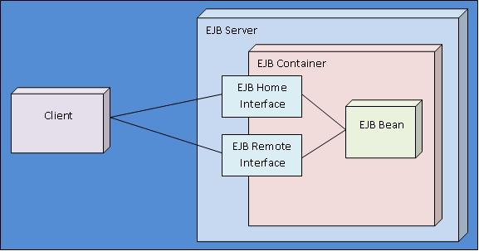
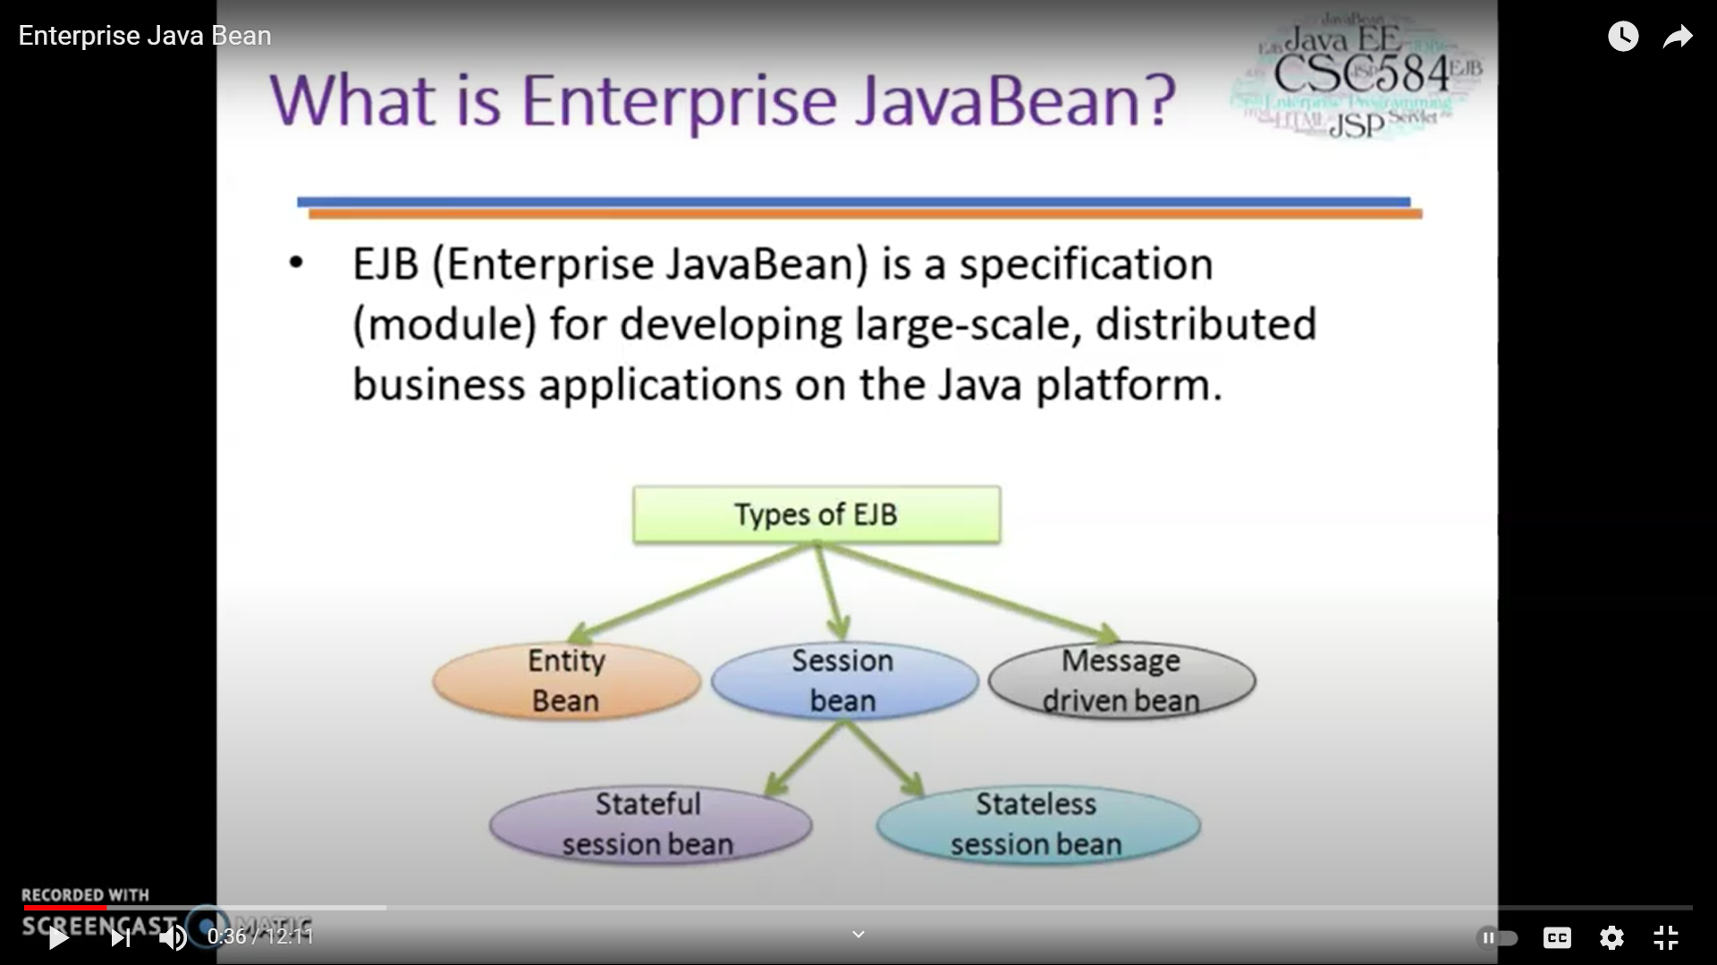
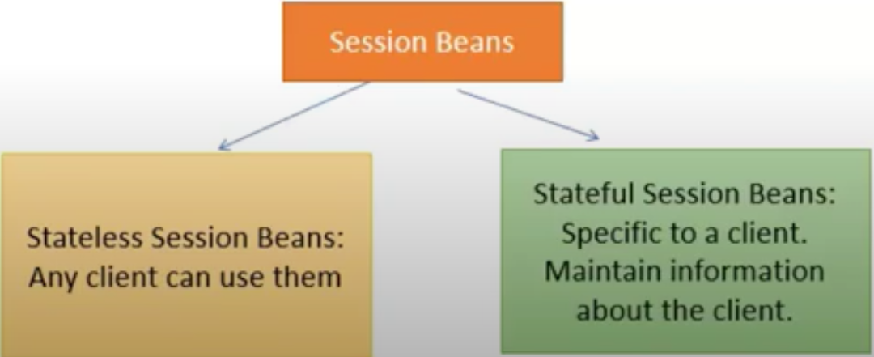
EJB Types
EJB Architecture

Slide 6
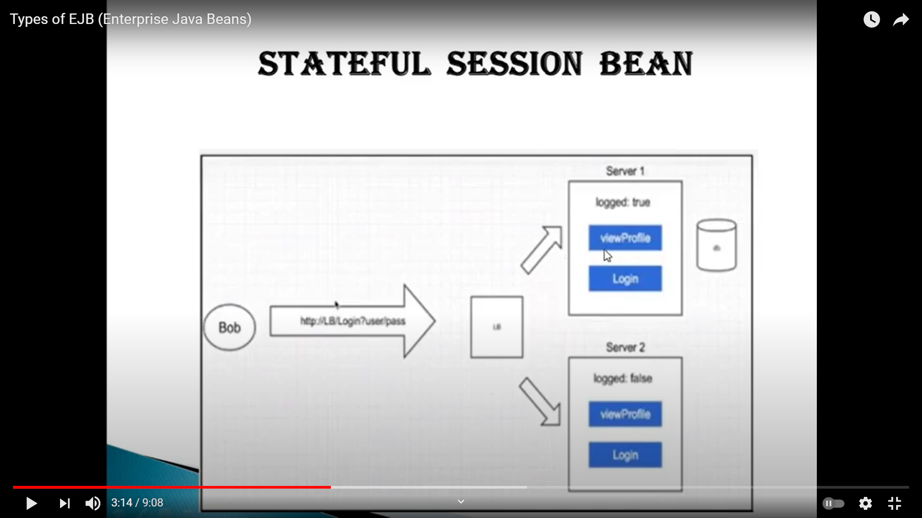
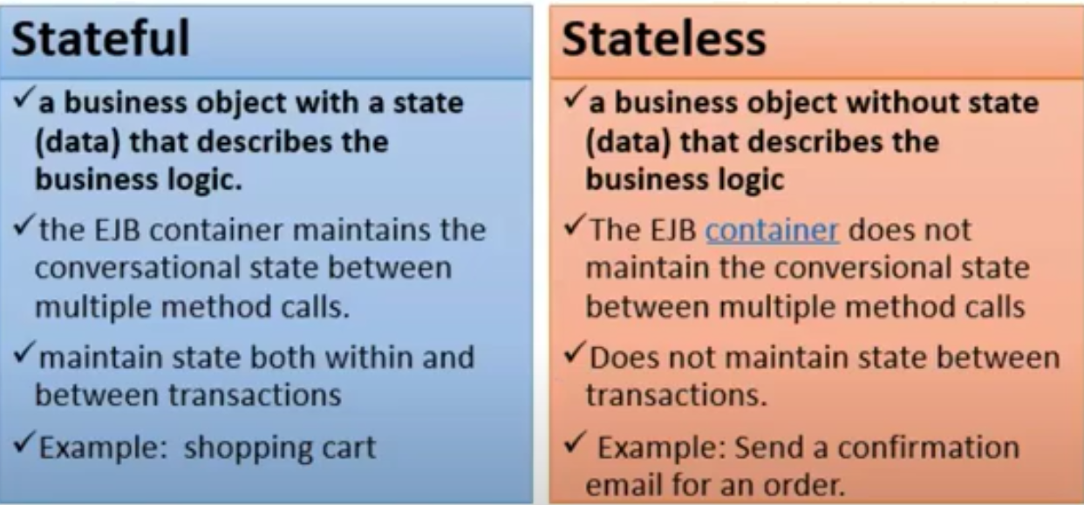
Stateful
Stateful Session Bean:
it maintains state of a client across multiple requests
Stateless Session Bean:
It doesn’t maintain state of a client between multiple method calls
It can be accessed by one client at a time

Slide 7
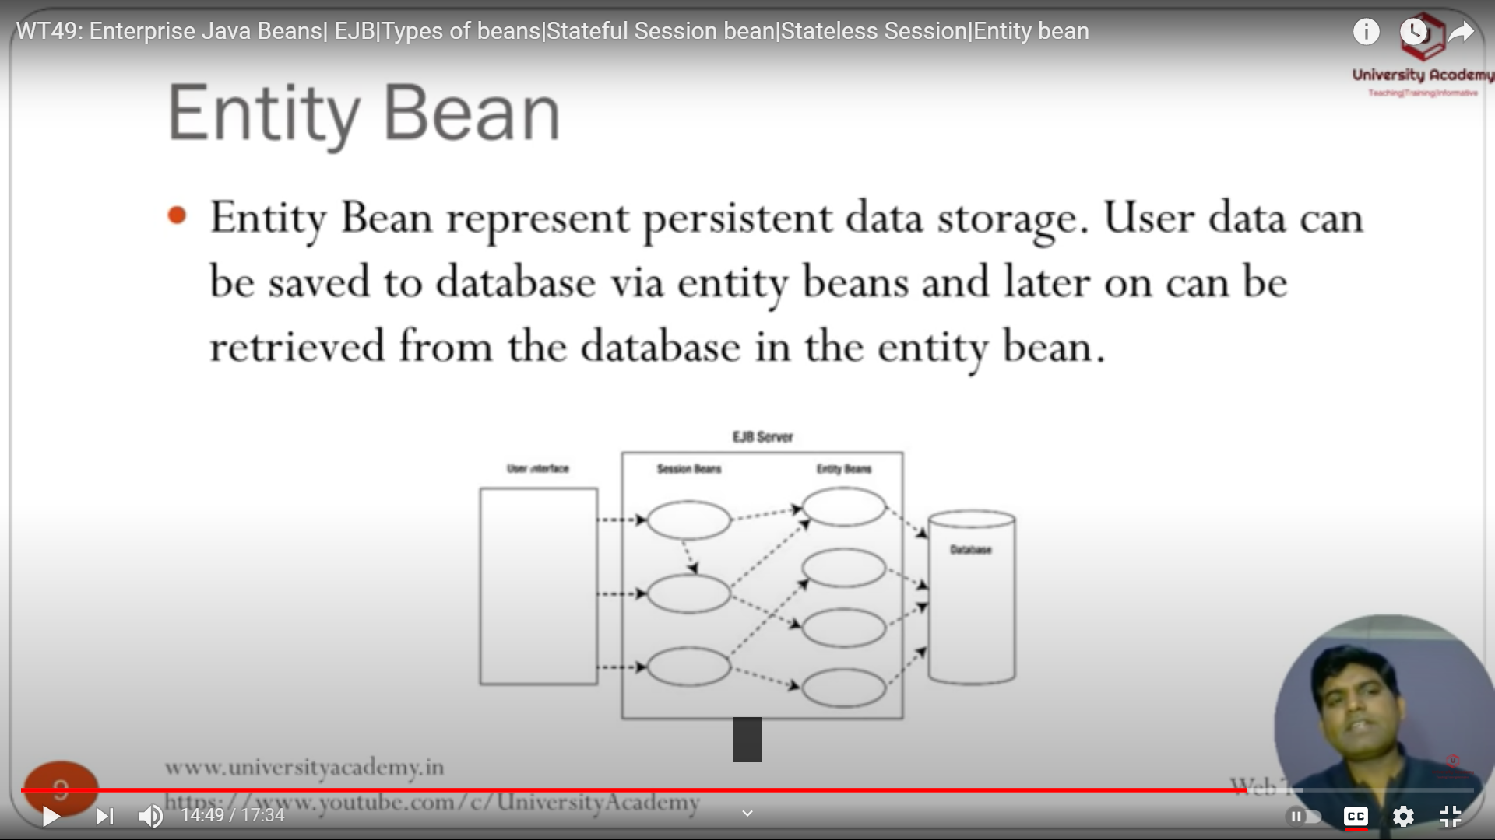
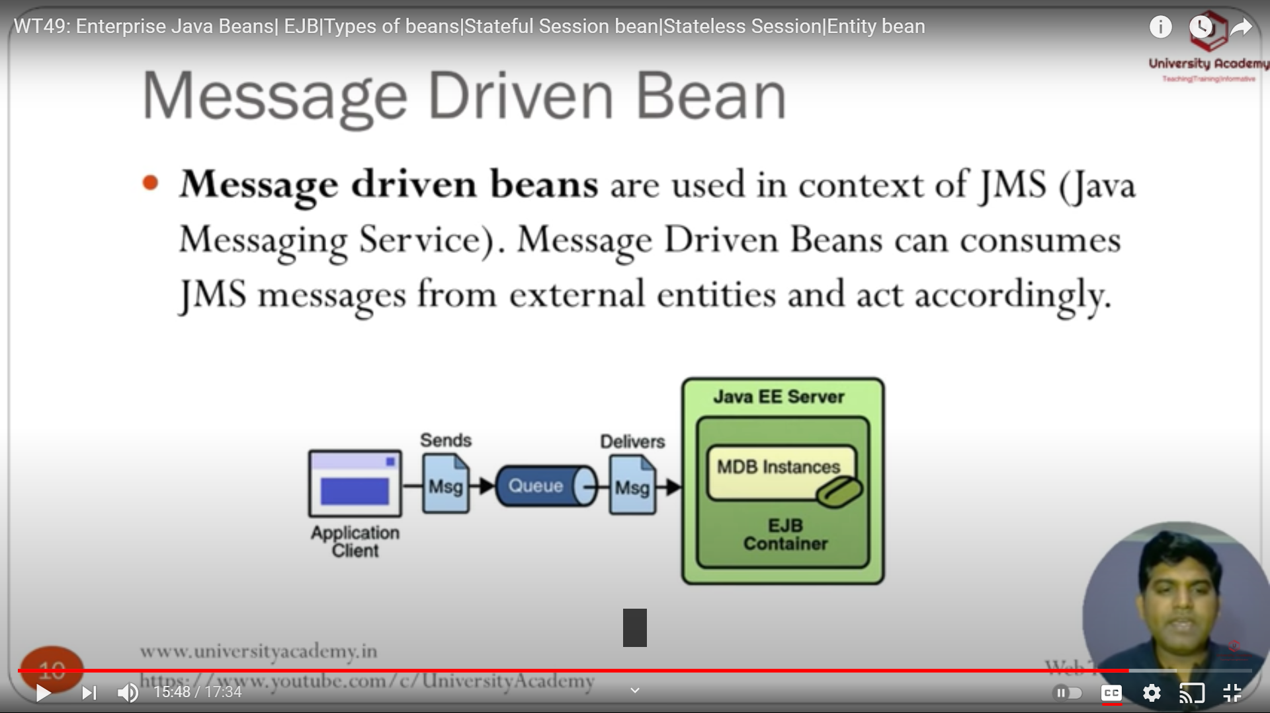
Entity Bean-:
Entity Bean represent persistent data storage user data can be saved to database via entity beans and later on can be retrieved from the database in the entity bean
Message driven Bean-:
Message driven beans are used in context of JMS (java messaging service) message driven beans can consumes JMS message from external entities and act accordingly

Slide 8
Naming Conventions for Enterprise Beans
Because enterprise beans are composed of multiple parts, it’s useful to follow a naming convention for your applications
Item | Syntax | Example
Enterprise bean name | nameBean | AccountBean
Enterprise bean class | nameBean | AccountBean
Business interface | name | Account

Slide 9
Distributed objects communication
EJB Communication
Three main distributed object services available
CORBA, platform and language independent
DCOM only use in Microsoft platform
Java RMI limited to the java remote method protocol
EJB use java RMI-IIOP
An implementation of the java RMI over IIOP, which combine the simplicity of the java RMI and platform and language independence of IIOP
Sun also provides API for EJB to communicate with CORRA based distributed objects
All communications are remote based

Slide 10
EJB Security
An EJB container manages standard security concerns or it can be customized to handle any specific security concerns.
Important Terms of Security:
Authentication
Authorization
User
User Groups
User Roles

Slide 11
Advantages of EJB
The EJB developer focuses on solving business problems and business logic.
EJB container helps in providing system-level services to enterprise Java beans.
It provides simplified development of large scale enterprise level application.
Disadvantages of EJB
It creates costly and complex solutions
It takes time for development

Slide 12
Thank You……….

